Slide 1
18CSC303J – Database Management Systems
Unit III – SQL & PL/SQL

Slide 2
Topics Covered
Basics of SQL- DDL,DML,TCL
Structure Creation
Constraints
Functions-Built-in , Aggregate
Subqueries
Set operations
Triggers
Query processing
Transaction control commands
Views
PL/SQL

Slide 3
Basics of SQL-DDL,DML,DCL,TCL

Slide 4
SQL
Structured Query Language(SQL) as we all know is the database language by the use of which we can perform certain operations on the existing database and also we can use this language to create a database. SQL uses certain commands like Create, Drop, Insert etc. to carry out the required tasks.
These SQL commands are mainly categorized into four categories as:
DDL – Data Definition Language
DML – Data Manipulation Language
DCL – Data Control Language
TCL – Transaction Control Language

Slide 5
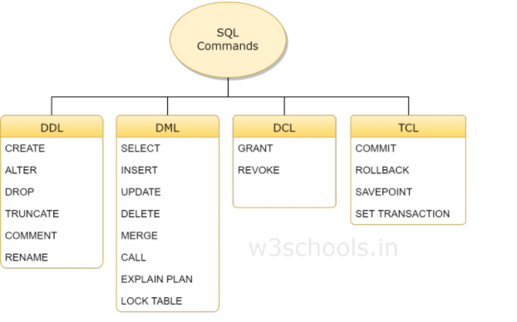

Slide 6
DDL Introduction
DDL is short name of Data Definition Language, which deals with database schemas and descriptions, of how the data should reside in the database.
CREATE - to create a database and its objects like (table, index, views, store procedure, function, and triggers)
ALTER - alters the structure of the existing database
DROP - delete objects from the database
TRUNCATE - remove all records from a table, including all spaces allocated for the records are removed
COMMENT - add comments to the data dictionary
RENAME - rename an object

Slide 7
DML Introduction
DML is short name of Data Manipulation Language which deals with data manipulation and includes most common SQL statements such SELECT, INSERT, UPDATE, DELETE, etc., and it is used to store, modify, retrieve, delete and update data in a database.
SELECT - retrieve data from a database
INSERT - insert data into a table
UPDATE - updates existing data within a table
DELETE - Delete all records from a database table

Slide 8
DCL Introduction
DCL is short name of Data Control Language which includes commands such as GRANT and mostly concerned with rights, permissions and other controls of the database system.
GRANT - allow users access privileges to the database
REVOKE - withdraw users access privileges given by using the GRANT command

Slide 9
TCL Introduction
TCL is short name of Transaction Control Language which deals with a transaction within a database.
COMMIT - commits a Transaction
ROLLBACK - rollback a transaction in case of any error occurs
SAVEPOINT - to rollback the transaction making points within groups
SET TRANSACTION - specify characteristics of the transaction

Slide 10
DDL-Structure creation Creating a Table
Syntax
CREATE TABLE table_name
(Column_name datatype[(size)],
Column_name datatype[(size)],
);
Example
CREATE TABLE stud
(Regno varchar2(10),
Name char(50),
DOB date,
Address varchar2(50));
Creates a table with four columns

Slide 11
Data Types
Following broad categories of data types exist in most databases:
String Data
Numeric Data
Temporal Data
Large Objects

Slide 12
String Data
Fixed Length:
Occupies the same length of space in memory no matter how much data is stored in them.
Syntax:
char(n) where n is the length of the String
e.g. name char(50)
If the variable stored for name is ‘Sanjay’ the extra 42 fields are padded with blanks

Slide 13
String Data
Variable Length string is specified with maximum length of characters possible in the string, however, the allocation is sized to the size of the data stored in memory.
Syntax:
Varchar(n) – n is the maximum length of data possible for the type
There may be a restriction in the maximum length of the data that you can specify in the declaration which will vary according to the database.
All character data has to be enclosed in single quotes during specification.

Slide 14
Numeric Data Types
Store all the data related to purely numeric data.
Some numeric data may also be stored as a character field e.g. zip codes
Common Numeric Types:
Decimal Floating point number
Float Floating point number
Integer(size) Integer of specified length
Money A number which contains exactly two
digits after the decimal point
Number A standard number field that can hold
a floating point data
Note: Different databases name their numeric fields differently and may not support all numeric types. They may also support additional numeric types.

Slide 15
Temporal Data Types
These represent the dates and time:
Three basic types are supported:
Dates
Times
Date-Time Combinations

Slide 16
Large Data Objects
These are used for storing data objects like files and images:
There are two types:
Character Large Objects (clobs)
Binary Large Objects (blobs)

Slide 17
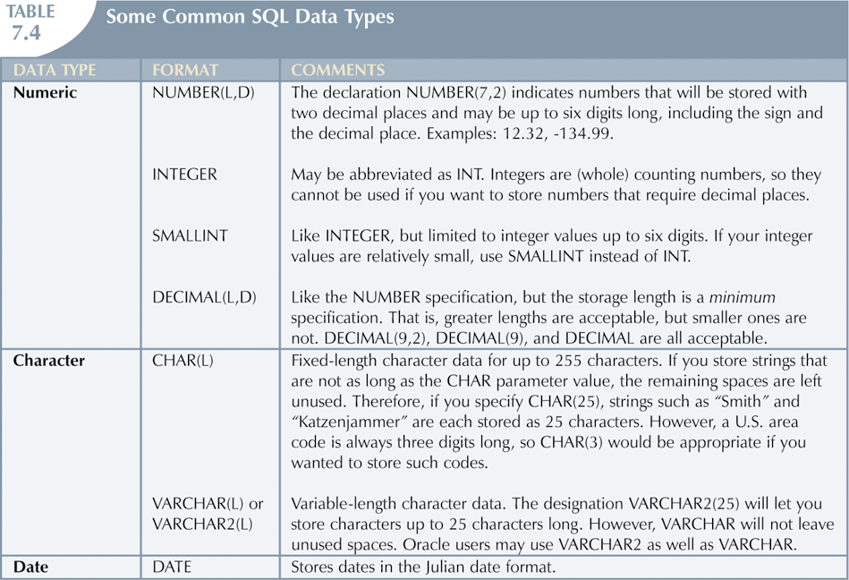

Slide 18
Alter Statement
Alter Statement:
used to make changes to the schema of the table. Columns can be added and the data type of the columns changed as long as the data in those columns conforms to the data type specified.
ALTER TABLE - ADD Column
Syntax:
ALTER TABLE table_name ADD column_name datatype;
Example:
ALTER TABLE stud ADD (Age number(2),
ADD Mark1 number(3),
ADD Mark2 number(3));
The stud table is already exist and then we added three more columns Age ,Mark1 and Mark2 respectively, by the use of above command.

Slide 19
Alter Statement(contd..)
2. ALTER TABLE - DROP COLUMN
Syntax:
ALTER TABLE table_name DROP COLUMN column_name;
Example:
ALTER TABLE stud
DROP COLUMN Mark2;
This command will drop particular column mark2.
3. ALTER TABLE - ALTER/MODIFY COLUMN
Syntax:
ALTER TABLE table_name MODIFY COLUMN column_name datatype;
Example:
ALTER TABLE stud
MODIFY (Name varchar2(60));
The Name column already exist in stud table, it was char and size 50, now it is modified by varchar2 and size 60.

Slide 20
Drop Table Statement
DROP TABLE
-Drop an existing table in a database.
Syntax:
DROP TABLE table_name;
Example:
DROP TABLE stud;
This will destroy the table and all data which will be recorded in it.

Slide 21
Truncate Table Statement
TRUNCATE TABLE
-Truncates the contents in an existing table in a database.
Syntax:
TRUNCATE TABLE table_name;
Example:
TRUNCATE TABLE stud;
This will delete the contents in the table. But structure remains the same

Slide 22
Rename Table Statement
RENAME TABLE
-Truncates the contents in an existing table in a database.
Syntax:
RENAME OldTableName
TO NewTableName;
Example:
RENAME stud
TO student;
The old name table was stud now new name is the student.

Slide 23
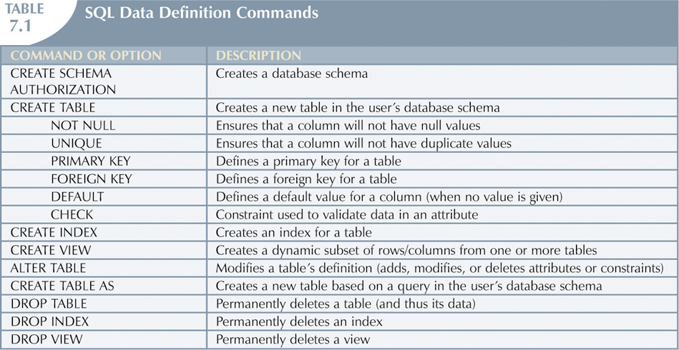

Slide 24
DML-Data Manipulation Language

Slide 25
Select Statement
To display only selected fields
Syntax:
SELECT column1, column2, ... FROM table_name;
Here, column1, column2, ... are the field names of the table you want to select data from
Example
SELECT name, age FROM stud;
To display all the fields available in the table
Syntax:
SELECT * FROM table_name;
Example
SELECT * FROM stud;

Slide 26
Insert Statement
The INSERT INTO statement is used to insert new records in a table.
Syntax:
INSERT INTO table_name VALUES (value1, value2, value3, ...);
Example
INSERT INTO stud VALUES (100, ‘Asha’, ‘27-Jan-2021’, ‘First Street’, 15, 89, 90);
1 row will be created
Insert NULL Value to a column
INSERT INTO stud VALUES (101, ‘Alex’, ‘27-feb-2021’, ‘Second Street’, null, 98, 79);
The above command will insert null to age column.
Insert Default value to a column
INSERT into Student values(103,'Chris')
Suppose the age column of student table has default value of 14.
Also, if you run the below query, it will insert default value into the age column, whatever the default value may be.

Slide 27
Where Clause
Where clause is used to specify condition while retrieving data from table. Where clause is used mostly with Select, Update and Delete query. If condition specified by where clause is true then only the result from table is returned.
Syntax:
SELECT column1, column2, ... FROM table_name WHERE condition;
Example
SELECT regno, name
FROM stud WHERE regno=101;
This displays only the regno and name of the stud with regno 101.
SELECT *FROM stud WHERE regno=101;
This displays the all the details of the stud with regno 101.

Slide 28
Update Statement
The UPDATE statement is used to modify the existing records in a table..
Syntax:
UPDATE table_name SET column1 = value1, column2 = value2, ... WHERE condition;;
Example
UPDATE stud SET name = 'Alfred ', age= 15 WHERE regno = 103;
The above command will update two columns of a record.

Slide 29
Delete Statement
The DELETE statement is used to delete all records in a table.
Syntax:
DELETE FROM table_name;
Example
DELETE FROM stud;
Delete command can also be used with condition to delete a particular row
Syntax:
DELETE FROM table_name
WHERE condition;
Example
DELETE FROM stud
WHERE regno=105;

Slide 30
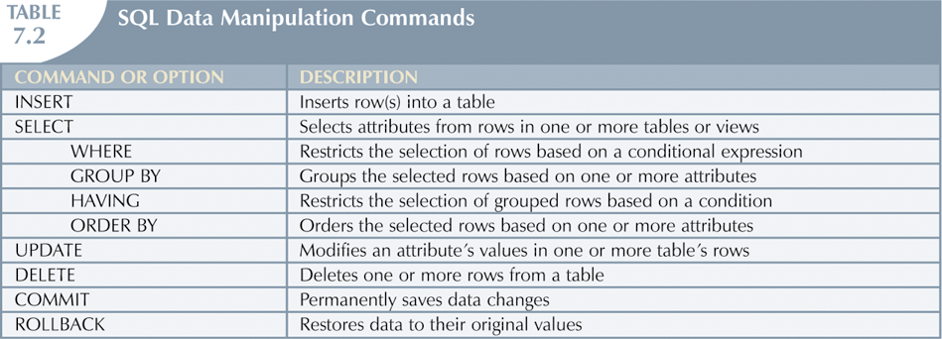

Slide 31
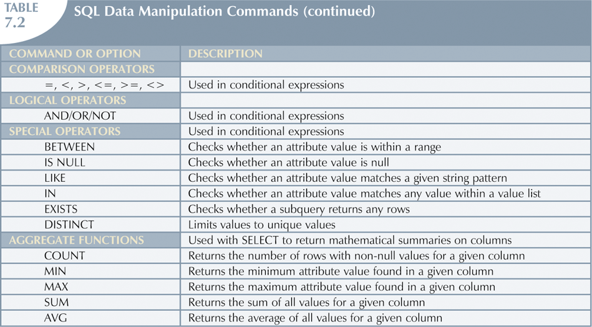

Slide 32
Constraints
Defining Constraints-Primary Key, Foreign Key, Unique, not null, check, IN operator

Slide 33
Constraints
Integrity constraints ensure that changes made to the database do not result in a loss of data consistency.
Examples:
• An instructor name cannot be null.
• No two instructors can have the same instructor ID.
• Every department name in the course relation must have a matching department name in the department relation.
• The budget of a department must be greater than $0.00.
integrity constraints that can be tested with minimal overhead (cost).

Slide 34
Constraints
(1) Integrity constraints are declared as part of the create table command
(2) Integrity constraints can also be added to an existing relation by using
alter table table-name add constraint
Constraints on a Single Relation
• primary key
• not null
• unique
• check(<predicate>)

Slide 35
Constraints
The general form of the create table command is:
create table r
(A1 D1,
A2 D2,
. . . ,
An Dn,
integrity-constraint1,
. . . ,
integrity-constraintk);
where r is the name of the relation, each Ai is the name of an attribute in the schema of relation r, and Di is the domain of attribute Ai; that is, Di specifies the type of attribute Ai along with optional constraints that restrict the set of allowed values for Ai .

Slide 36
Constraints
Primary key
primary key (Aj1 , Aj2, . . . , Ajm ): The attributes Aj1 , Aj2, . . . , Ajm form the primary key for the relation. The primary key attributes are required to be not null and unique;
• foreign key (Ak1 , Ak2, . . . , Akn ) references s: The values of attributes (Ak1 , Ak2, . . . , Akn ) for any tuple in the relation must correspond to values of the primary key attributes of some tuple in relation s.

Slide 37
Constraints
Example:
create table department
(dept name varchar (20),
building varchar (15),
budget numeric (12,2),
primary key (dept name));
create table course
(course id varchar (7),
title varchar (50),
dept name varchar (20),
credits numeric (2,0),
primary key (course id),
foreign key (dept name) references department);

Slide 38
Constraints
Not Null Constraint
For certain attributes, null values may be inappropriate.
prohibits the insertion of a null value for the attribute. That is the null value is not allowed for that attribute.
Example:
create table instructor
(ID varchar (5),
name varchar (20) not null,
dept name varchar (20),
salary numeric (8,2),
primary key (ID),
foreign key (dept name) references department);

Slide 39
Constraints
Unique Constraint
unique (Aj1 , Aj2, . . . , Ajm )
attributes Aj1 , Aj2, . . . , Ajm
key; that is, no two tuples in the relation can be equal on all the listed attributes.

Slide 40
Constraints
The check Clause
The clause check(P) specifies a predicate P that must be satisfied by every tuple in a relation.
ensure that attribute values satisfy specified conditions
Example:
create table section
(course id varchar (8),
sec id varchar (8),
semester varchar (6),
year numeric (4),
building varchar (15),
room number varchar (7),
time slot id varchar (4),
primary key (course id),
check (semester in (’RAINFall’, ’Winter’, ’Spring’, ’Summer’)));

Slide 41
Constraints
Referential Integrity
ensure that a value in one relation for a given set of attributes also appears for a certain set of attributes in another relation.
Foreign keys can be specified as part of the SQL create table statement by using the foreign key clause
Example: “foreign key (dept name) references department”
Let r1 and r2 be relations whose set of attributes are R1 and R2, respectively, with primary keys K1 and K2. The subset of R2 is a foreign key referencing K1 in relation r1 if it is required that, for every tuple t2 in r2, there must be a tuple t1 in r1 such that t1.K1 = t2..

Slide 42
Constraints
Referential Integrity
create table department
(dept name varchar (20),
Building name varchar (15),
budget numeric (12,2) check (budget > 0),
primary key (dept name))
create table course
(course id varchar (8),
title varchar (50),
dept name varchar (20),
credits numeric (2) check (credits > 0),
primary key (course id),
foreign key (dept name) references department)

Slide 43
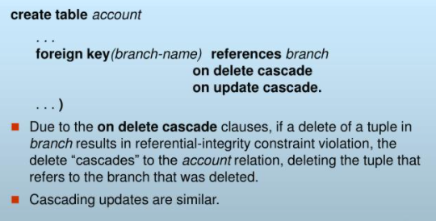
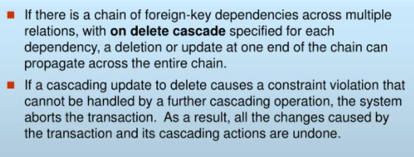
Constraints

Slide 44
SQL
Built-in Functions

Slide 45
What are Built-In Functions?
In SQL a built-in function is a piece for programming that takes zero or more inputs and returns a value.
An example of a built-in function is ABS(), which when given a value calculates the absolute (non-negative) value of the number.
ABS () are used to perform calculations.
GETDATE () are used to obtain a system value, such as the current date.
LEFT (), are used to manipulate textual data.
SELECT Name,
ABS(500 - ReorderPoint) ReorderPointDeviation
FROM production.Product
WHERE ABS(500 - ReorderPoint) > 200

Slide 46
Function Categories
Numeric Functions – perform advanced calculations and round numbers.
String Functions – change text values to all upper case, or remove the trailing spaces from values.
Conversion Functions – Convert data with CAST and CONVERT
Group Functions- functions that operate on groups of rows and return one value for the entire group
Date Functions – add days or months to a date. Calculate the day of the week from the date.

Slide 47
Numeric Functions
Function | Input Argument | Value Returned
ABS ( m ) | m = value | Absolute value of m
MOD ( m, n ) | m = value, n = divisor | Remainder of m divided by n
POWER ( m, n ) | m = value, n = exponent | m raised to the nth power
ROUND ( m [, n ] ) | m = value, n = number of decimal places, default 0 | m rounded to the nth decimal place
TRUNC ( m [, n ] ) | m = value, n = number of decimal places, default 0 | m truncated to the nth decimal place
SIN ( n ) | n = angle expressed in radians | sine (n)
COS ( n ) | n = angle expressed in radians | cosine (n)
TAN ( n ) | n = angle expressed in radians | tan (n)
ASIN ( n ) | n is in the range -1 to +1 | arc sine of n in the range -π/2 to +π/2
ACOS ( n ) | n is in the range -1 to +1 | arc cosine of n in the range 0 to π
ATAN ( n ) | n is unbounded | arc tangent of n in the range -π/2 to + π/2
SINH ( n ) | n = value | hyperbolic sine of n
COSH ( n ) | n = value | hyperbolic cosine of n
TANH ( n ) | n = value | hyperbolic tangent of n
SQRT ( n ) | n = value | positive square root of n
EXP ( n ) | n = value | e raised to the power n
LN ( n ) | n > 0 | natural logarithm of n
LOG ( n2, n1 ) | base n2 any positive value other than 0 or 1, n1 any positive value | logarithm of n1, base n2
CEIL ( n ) | n = value | smallest integer greater than or equal to n
FLOOR ( n ) | n = value | greatest integer smaller than or equal to n
SIGN ( n ) | n = value | -1 if n < 0, 0 if n = 0, and 1 if n > 0

Slide 48
Here are some examples of the use of some of these numeric functions:
 | select select select | round (83.28749, sqrt (3.67) from power (2.512, 5) | 2) from dual; dual; from dual;
String Functions
Function | Input Argument | Value Returned
INITCAP ( s ) | s = character string | First letter of each word is changed to uppercase and all other letters are in lower case.
LOWER ( s ) | s = character string | All letters are changed to lowercase.
UPPER ( s ) | s = character string | All letters are changed to uppercase.
CONCAT ( s1, s2 ) | s1 and s2 are character strings | Concatenation of s1 and s2. Equivalent to s1 || s2
LPAD ( s1, n [, s2] ) | s1 and s2 are character strings and n is an integer value | Returns s1 right justified and padded left with n characters from s2; s2 defaults to space.
RPAD ( s1, n [, s2] ) | s1 and s2 are character strings and n is an integer value | Returns s1 left justified and padded right with n characters from s2; s2 defaults to space.
LTRIM ( s [, set ] ) | s is a character string and set is a set of characters | Returns s with characters removed up to the first character not in set; defaults to space
RTRIM ( s [, set ] ) | s is a character string and set is a set of characters | Returns s with final characters removed after the last character not in set; defaults to space

Slide 49
String Functions
REPLACE ( s, search_s [, replace_s ] ) | s = character string, search_s = target string, replace_s = replacement string | Returns s with every occurrence of search_s in s replaced by replace_s; default removes search_s
SUBSTR ( s, m [, n ] ) | s = character string, m = beginning position, n = number of characters | Returns a substring from s, beginning in position m and n characters long; default returns to end of s.
LENGTH ( s ) | s = character string | Returns the number of characters in s.
INSTR ( s1, s2 [, m [, n ] ] ) | s1 and s2 are character strings, m = beginning position, n = occurrence of s2 in s1 | Returns the position of the nth occurrence of s2 in s1, beginning at position m, both m and n default to 1.
Here are some examples of the use of String functions:
select concat ('Alan', 'Turing') as "NAME" from dual; select 'Alan' || 'Turing' as "NAME" from dual;
select initcap ("now is the time for all good men to come to the aid of the party") as "SLOGAN" from dual;
select substr ('Alan Turing', 1, 4) as "FIRST" from dual;

Slide 50
String / Number Conversion Functions
Function | Input Argument | Value Returned
NANVL ( n2, n1 ) | n1, n2 = value | if (n2 = NaN) returns n1 else returns n2
TO_CHAR ( m [, fmt ] ) | m = numeric value, fmt = format | Number m converted to character string as specified by the format
TO_NUMBER ( s [, fmt ] ) | s = character string, fmt = format | Character string s converted to a number as specified by the format
Formats for TO_CHAR Function
Symbol | Explanation
9 | Each 9 represents one digit in the result
0 | Represents a leading zero to be displayed
$ | Floating dollar sign printed to the left of number
L | Any local floating currency symbol
. | Prints the decimal point
, | Prints the comma to represent thousands

Slide 51
Group Functions
Function | Input Argument | Value Returned
AVG ( [ DISTINCT | ALL ] col ) | col = column name | The average value of that column
COUNT ( * ) | none | Number of rows returned including duplicates and NULLs
COUNT ( [ DISTINCT | ALL ] col ) | col = column name | Number of rows where the value of the column is not NULL
MAX ( [ DISTINCT | ALL ] col ) | col = column name | Maximum value in the column
MIN ( [ DISTINCT | ALL ] col ) | col = column name | Minimum value in the column
SUM ( [ DISTINCT | ALL ] col ) | col = column name | Sum of the values in the column
CORR ( e1, e2 ) | e1 and e2 are column names | Correlation coefficient between the two columns after eliminating nulls
MEDIAN ( col ) | col = column name | Middle value in the sorted column, interpolating if necessary
STDDEV ( [ DISTINCT | ALL ] col ) | col = column name | Standard deviation of the column ignoring NULL values
VARIANCE ( [ DISTINCT | ALL ] col ) | col = column name | Variance of the column ignoring NULL values

Slide 52
AGGREGATE FUNCTIONS
An aggregate function performs a calculation on a set of values, and returns a single value.
Performing calculations on multiple rows Of a single column of a table And returning a single value.

Slide 53
LIST OF AGGREGATE FUNCTIONS
1) COUNT 2) SUM 3) AVG 4) MIN 5) MAX

Slide 54
COUNT()
COUNT counts how many rows are in a particular column.
This function returns the number of rows in the table that satisfies the condition specified in the WHERE condition. If the WHERE condition is not specified, then the query returns the total number of rows in the table.
Syntax:
Select count(*) from table name ;

Slide 55
SUM():
SUM adds together all the values in a particular column.
This function is used to get the sum of a numeric column
Syntax:
Select sum(columnname) from table name;

Slide 56
MIN():
MIN return the lowest values in a particular column.
This function is used to get the minimum value from a column
Syntax:
Select min(column name) from table name;

Slide 57
Max()
MAX return the highest values in a particular column.
This function is used to get the maximum value from a column
Syntax:
Select max(column name) from table name;

Slide 58
AVG:
AVG calculates the average of a group of selected values.
This function is used to get the average value of a numeric column.
Syntax:
select avg(column name) from table name;

Slide 59
Example for aggregate function
Id Name Salary
A 80
B 40
C 60
D 70
E 60
F Null

Slide 60
Count():
Count(*): Returns total number of records .i.e 6. Count(salary): Return number of Non Null values over the column salary. i.e 5. Count(Distinct Salary): Return number of distinct Non Null values over the column salary .i.e 4

Slide 61
Sum():
This function is used to get the sum of a numeric column
sum(salary): Sum all Non Null values of Column salary i.e., 310 sum(Distinct salary): Sum of all distinct Non-Null values i.e., 250.

Slide 62
Avg():
Avg(salary) = Sum(salary) / count(salary) = 310/5 Avg(Distinct salary) = sum(Distinct salary) / Count(Distinct Salary) = 250/4

Slide 63
Min():
Min(salary): Minimum value in the salary column except NULL i.e., 40. Max(salary): Maximum value in the salary i.e., 80.

Slide 64
SQL DISTINCT ():
This function is used to select the distinct rows.
Count(Distinct Salary): Return number of distinct Non Null values over the column salary .i.e 4

Slide 65
Date and Time Functions
Function | Input Argument | Value Returned
ADD_MONTHS ( d, n ) | d = date, n = number of months | Date d plus n months
LAST_DAY ( d ) | d = date | Date of the last day of the month containing d
MONTHS_BETWEEN ( d, e ) | d and e are dates | Number of months by which e precedes d
NEW_TIME ( d, a, b ) | d = date, a = time zone (char), b = time zone (char) | The date and time in time zone b when date d is for time zone a
NEXT_DAY ( d, day ) | d = date, day = day of the week | Date of the first day of the week after d
SYSDATE | none | Current date and time
GREATEST ( d1, d2, ..., dn ) | d1 ... dn = list of dates | Latest of the given dates
LEAST ( d1, d2, ..., dn ) | d1 ... dn = list of dates | Earliest of the given dates
Date Conversion Functions
Function | Input Argument | Value Returned
TO_CHAR ( d [, fmt ] ) | d = date value, fmt = format for string | The date d converted to a string in the given format
TO_DATE ( s [, fmt ] ) | s = character string, fmt = format for date | String s converted to a date value
ROUND ( d [, fmt ] ) | d = date value, fmt = format for string | Date d rounded as specified by the format
TRUNC ( d [, fmt ] ) | d = date value, fmt = format for string | Date d truncated as specified by the format

Slide 66
Date Formats
Format Code | Description | Range of Values
DD | Day of the month | 1 - 31
DY | Name of the day in 3 uppercase letters | SUN, ..., SAT
DAY | Complete name of the day in uppercase, padded to 9 characters | SUNDAY, ..., SATURDAY
MM | Number of the month | 1 - 12
MON | Name of the month in 3 uppercase letters | JAN, ..., DEC
MONTH | Name of the month in uppercase padded to a length of 9 characters | JANUARY, ..., DECEMBER
RM | Roman numeral for the month | I, ..., XII
YY or YYYY | Two or four digit year | 71 or 1971
HH:MI:SS | Hours : Minutes : Seconds | 10:28:53
HH 12 or HH 24 | Hour displayed in 12 or 24 hour format | 1 - 12 or 1 - 24
MI | Minutes of the hour | 0 - 59
SS | Seconds of the minute | 0 - 59
AM or PM | Meridian indicator | AM or PM
SP | A suffix that forces the number to be spelled out. | e.g. TWO THOUSAND NINE
TH | A suffix meaning that the ordinal number is to be added | e.g. 1st, 2nd, 3rd, ...
FM | Prefix to DAY or MONTH or YEAR to suppress padding | e.g. MONDAY with no extra spaces at the end

Slide 67
Here are some examples of the use of the Date functions:
select to_char ( sysdate, 'MON DD, YYYY' ) from dual; select to_char ( sysdate, 'HH12:MI:SS AM' ) from dual;
select to_char( new_time(sysdate,'CDT','GMT'),'HH24:MI')from dual; select greatest (to_date ( 'JAN 19, 2000', 'MON DD, YYYY' ),
to_date ( 'SEP 27, 1999', 'MON DD, YYYY' ), to_date ( '13-Mar-2009', 'DD-Mon-YYYY' ) )
from dual;
select next_day ( sysdate, 'FRIDAY' ) from dual;

Slide 68
Subqueries

Slide 69
Subqueries
In SQL a Subquery can be simply defined as a query within another query.
Subquery is defined as a query that is embedded in WHERE clause of another SQL query.
A query can be processed inside another query.
A subquery is select statement that is embedded in the clause of another select statement
Inner query and outer query : inner query returns a value that is used by outer query.

Slide 70
Subqueries
Important rules for Subqueries:
Subquery can be placed in a number of SQL clauses: WHERE clause, HAVING clause, FROM clause. Subqueries can be used with SELECT, UPDATE, INSERT, DELETE statements along with expression operator. It could be equality operator or comparison operator such as =, >, =, <= and Like operator.
A subquery is a query within another query. The outer query is called as main query and inner query is called as subquery.
The subquery generally executes first, and its output is used to complete the query condition for the main or outer query.
Subquery must be enclosed in parentheses.
Subqueries are on the right side of the comparison operator.
ORDER BY command cannot be used in a Subquery. GROUPBY command can be used to perform same function as ORDER BY command.
Use single-row operators with singlerow Subqueries. Use multiple-row operators with multiple-row Subqueries.

Slide 71
Subqueries
Syntax:
SELECT column_name FROM table_name WHERE column_name expression operator ( SELECT COLUMN_NAME from TABLE_NAME WHERE column_name expression operator );

Slide 72
Subqueries
DATABASE TABLE
NAME ROLL_NO LOCATION PHONENUMBER
Ram 101 Chennai 9988775566
Raj 102 Coimbatore 8877665544
Sasi 103 Madurai 7766553344
Ravi 104 Salem 8989898989
Sumathi 105 Kanchipuram 8989856868

Slide 73
Subqueries
STUDENT TABLE
NAME ROLL_NO SECTION
Ravi 104 A
Sumathi 105 B
Raj 102 A

Slide 74
Subqueries
To display NAME, LOCATION, PHONE_NUMBER of the students from DATABASE table whose section is A
Select NAME, LOCATION, PHONE_NUMBER from DATABASE WHERE ROLL_NO IN
(SELECT ROLL_NO from STUDENT where SECTION=’A’);

Slide 75
Subqueries
Explanation : First subquery executes “ SELECT ROLL_NO from STUDENT where SECTION=’A’ ” returns ROLL_NO from STUDENT table whose SECTION is ‘A’.Then outer-query executes it and return the NAME, LOCATION, PHONE_NUMBER from the DATABASE table of the student whose ROLL_NO is returned from inner subquery.

Slide 76
Subqueries
Output:
NAME ROLL_NO LOCATION PHONENUMBER
Ravi 104 Salem 8989898989
Raj 102 Coimbatore 8877665544

Slide 77
NESTED QUERIES
A Subquery or Inner query or a Nested query is a query within another SQL query and embedded within the WHERE clause.
A subquery is used to return data that will be used in the main query as a condition to further restrict the data to be retrieved
Syntax:
SELECT column_name [, column_name ] FROM table1 [, table2 ] WHERE column_name OPERATOR (SELECT column_name [, column_name ] FROM table1 [, table2 ] [WHERE] condition)

Slide 78
SUB-QUERIES OR NESTED QUERIES
ID | NAME | AGE | ADDRESS | SALARY |
+----+----------+-----+-----------+----------+
| 1 | Ramesh | 35 | Ahmedabad | 2000.00 |
| 2 | Khilan | 25 | Delhi | 1500.00 |
| 3 | kaushik | 23 | Kota | 2000.00 |
| 4 | Chaitali | 25 | Mumbai | 6500.00 |
| 5 | Hardik | 27 | Bhopal | 8500.00 |
| 6 | Komal | 22 | MP | 4500.00 |
| 7 | Muffy | 24 | Indore | 10000.00 |
+----+----------+-----+-----------+----------+

Slide 79
SQL> SELECT * FROM CUSTOMERS WHERE ID IN (SELECT ID FROM CUSTOMERS WHERE SALARY > 4500) ;

Slide 80
ID | NAME | AGE | ADDRESS | SALARY |
+----+----------+-----+---------+----------+
| 4 | Chaitali | 25 | Mumbai | 6500.00 |
| 5 | Hardik | 27 | Bhopal | 8500.00 |
| 7 | Muffy | 24 | Indore | 10000.00 |
+----+----------+-----+---------+----------+

Slide 81
CLAUSES IN SQL
CLAUSES USING IN SQL:
HAVING
GROUP BY
ORDER BY

Slide 82
Using Having clause..
The HAVING Clause enables you to specify conditions that filter which group results appear in the results.
The WHERE clause places conditions on the selected columns, whereas the HAVING clause places conditions on groups created by the GROUP BY clause.
The HAVING clause must follow the GROUP BY clause in a query and must also precede the ORDER BY clause if used. The following code block has the syntax of the SELECT statement including the HAVING clause −

Slide 83
Using Having clause..
Syntax
The following code block shows the position of the HAVING Clause in a query.
SELECT column1, column2 FROM table1, table2 WHERE [ conditions ] GROUP BY column1, column2 HAVING [ conditions ] ORDER BY column1, column2

Slide 84
Using Having clause..
Example
Consider the CUSTOMERS table having the following records.

Slide 85
Using Having clause..
ID | NAME | AGE | ADDRESS | SALARY |
+----+----------+-----+-----------+----------+
| 1 | Ramesh | 32 | Ahmedabad | 2000.00 |
| 2 | Khilan | 25 | Delhi | 1500.00 |
| 3 | kaushik | 23 | Kota | 2000.00 |
| 4 | Chaitali | 25 | Mumbai | 6500.00 |
| 5 | Hardik | 27 | Bhopal | 8500.00 |
| 6 | Komal | 22 | MP | 4500.00 |
| 7 | Muffy | 24 | Indore | 10000.00 |

Slide 86
Using Having clause..
Following is an example, which would display a record for a similar age count that would be more than or equal to 32.
SQL > SELECT ID, NAME, AGE, ADDRESS, SALARY FROM CUSTOMERS GROUP BY age HAVING (age) >= 32;

Slide 87
Using Having clause..
ID | NAME | AGE | ADDRESS | SALARY |
+----+--------+-----+---------+---------+
| 1 | Ramesh | 32 | Ahamadabad | 2000.00 |

Slide 88
Using Groupby clause..
The SQL GROUP BY clause is used in collaboration with the SELECT statement to arrange identical data into groups. This GROUP BY clause follows the WHERE clause in a SELECT statement and precedes the ORDER BY clause.
Syntax
The basic syntax of a GROUP BY clause is shown in the following code block. The GROUP BY clause must follow the conditions in the WHERE clause and must precede the ORDER BY clause if one is used.

Slide 89
Using Groupby clause..
Syntax:
SELECT column1, column2 FROM table_name WHERE [ conditions ] GROUP BY column1, column2 ORDER BY column1, column2

Slide 90
Using Groupby clause..
Example:
ID | NAME | AGE | ADDRESS | SALARY |
+----+----------+-----+-----------+----------+
| 1 | Ramesh | 32 | Ahmedabad | 2000.00 |
| 2 | Khilan | 25 | Delhi | 1500.00 |
| 3 | kaushik | 23 | Kota | 2000.00 |
| 4 | Chaitali | 25 | Mumbai | 6500.00 |
| 5 | Hardik | 27 | Bhopal | 8500.00 |
| 6 | Komal | 22 | MP | 4500.00 |
| 7 | Muffy | 24 | Indore | 10000.00 |

Slide 91
Using Groupby clause..
If you want to know the total amount of the salary on each customer, then the GROUP BY query would be as follows.
SQL> SELECT NAME, SUM(SALARY) FROM CUSTOMERS GROUP BY NAME;

Slide 92
Using Groupby clause..
NAME | SUM(SALARY) |
+----------+-------------+
| Chaitali | 6500.00 |
| Hardik | 8500.00 |
| kaushik | 2000.00 |
| Khilan | 1500.00 |
| Komal | 4500.00 |
| Muffy | 10000.00 |
| Ramesh | 2000.00 |

Slide 93
Using Groupby clause..
let us look at a table where the CUSTOMERS table has the following records with duplicate names −
ID | NAME | AGE | ADDRESS | SALARY |
+----+----------+-----+-----------+----------+
| 1 | Ramesh | 32 | Ahmedabad | 2000.00 |
| 2 | Ramesh | 25 | Delhi | 1500.00 |
| 3 | kaushik | 23 | Kota | 2000.00 |
| 4 | kaushik | 25 | Mumbai | 6500.00 |
| 5 | Hardik | 27 | Bhopal | 8500.00 | | 6 | Komal | 22 | MP | 4500.00 |
| 7 | Muffy | 24 | Indore | 10000.00 |
+----+----------+-----+-----------+----------+

Slide 94
Using Groupby clause..
Now again, if you want to know the total amount of salary on each customer, then the GROUP BY query would be as follows −
SQL> SELECT NAME, SUM(SALARY) FROM CUSTOMERS GROUP BY NAME;

Slide 95
Using Groupby clause..
NAME | SUM(SALARY) |
+---------+-------------+
| Hardik | 8500.00 |
| kaushik | 8500.00 |
| Komal | 4500.00 |
| Muffy | 10000.00 |
| Ramesh | 3500.00 |
+---------+-------------+

Slide 96
Using Orderby clause..
The SQL ORDER BY clause is used to sort the data in ascending or descending order, based on one or more columns. Some databases sort the query results in an ascending order by default.
Syntax
The basic syntax of the ORDER BY clause is as follows −
SELECT column-list FROM table_name [WHERE condition] [ORDER BY column1, column2, .. columnN] [ASC | DESC];

Slide 97
Using Orderby clause..
We can use more than one column in the ORDER BY clause. Make sure whatever column you are using to sort that column should be in the column-list.
Example
Consider the CUSTOMERS table having the following records −

Slide 98
Using Orderby clause..
ID | NAME | AGE | ADDRESS | SALARY |
+----+----------+-----+-----------+----------+
| 1 | Ramesh | 32 | Ahmedabad | 2000.00 |
| 2 | Khilan | 25 | Delhi | 1500.00 |
| 3 | kaushik | 23 | Kota | 2000.00 |
| 4 | Chaitali | 25 | Mumbai | 6500.00 |
| 5 | Hardik | 27 | Bhopal | 8500.00 |
| 6 | Komal | 22 | MP | 4500.00 |
| 7 | Muffy | 24 | Indore | 10000.00 |

Slide 99
Using Orderby clause..
The following code block has an example, which would sort the result in an ascending order by the NAME −
SQL> SELECT * FROM CUSTOMERS ORDER BY NAME;

Slide 100
Using Orderby clause..
ID | NAME | AGE | ADDRESS | SALARY |
+----+----------+-----+-----------+----------+
| 4 | Chaitali | 25 | Mumbai | 6500.00 |
| 5 | Hardik | 27 | Bhopal | 8500.00 |
| 3 | kaushik | 23 | Kota | 2000.00 |
| 2 | Khilan | 25 | Delhi | 1500.00 |
| 6 | Komal | 22 | MP | 4500.00 |
| 7 | Muffy | 24 | Indore | 10000.00 |
| 1 | Ramesh | 32 | Ahmedabad | 2000.00 |

Slide 101
Using Orderby clause..
The following code block has an example, which would sort the result in the descending order by NAME.
SQL> SELECT * FROM CUSTOMERS ORDER BY NAME DESC;
This would produce the following result −

Slide 102
Using Orderby clause..
ID | NAME | AGE | ADDRESS | SALARY |
+----+----------+-----+-----------+----------+
| 1 | Ramesh | 32 | Ahmedabad | 2000.00 |
| 7 | Muffy | 24 | Indore | 10000.00 |
| 6 | Komal | 22 | MP | 4500.00 |
| 2 | Khilan | 25 | Delhi | 1500.00 |
| 3 | kaushik | 23 | Kota | 2000.00 |
| 5 | Hardik | 27 | Bhopal | 8500.00 |
| 4 | Chaitali | 25 | Mumbai | 6500.00 |
+----+----------+-----+-----------+----------+

Slide 103
JOIN STATEMENTS
A SQL Join statement is used to combine data or rows from two or more tables based on a common field between them. Different types of Joins are:
INNER JOIN
LEFT JOIN (LEFT OUTER JOIN)
RIGHT JOIN(RIGHT OUTER JOIN)
FULL JOIN (OUTER JOIN OR FULL OUTER JOIN)

Slide 104
JOIN STATEMENTS
INNER JOIN:
Returns records that have matching values in both tables.
The INNER JOIN keyword selects all rows from both the tables as long as the condition satisfies. This keyword will create the result-set by combining all rows from both the tables where the condition satisfies i.e value of the common field will be same.

Slide 105
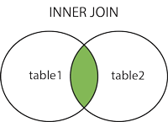
JOIN STATEMENTS

Slide 106
JOIN STATEMENTS
Syntax:
SELECTtable1.column1,table1.column2,table2.column1,.... FROM table1 INNER JOIN table2 ON table1.matching_column = table2.matching_column;
table1: First table.
table2: Second table
matching_column: Column common to both the tables.

Slide 107
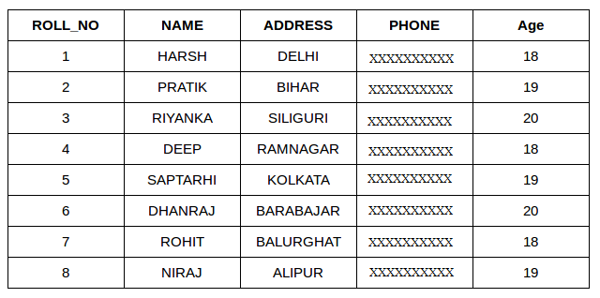
JOIN STATEMENTS
STUDENT

Slide 108
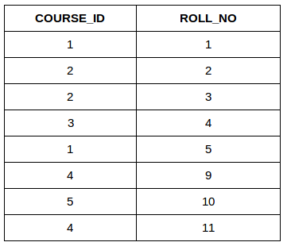
JOIN STATEMENTS
STUDENTCOURSE

Slide 109
JOIN STATEMENTS
This query will show the names and age of students enrolled in different courses.
SELECT StudentCourse.COURSE_ID, Student.NAME, Student.AGE FROM Student INNER JOIN StudentCourse ON Student.ROLL_NO = StudentCourse.ROLL_NO;

Slide 110
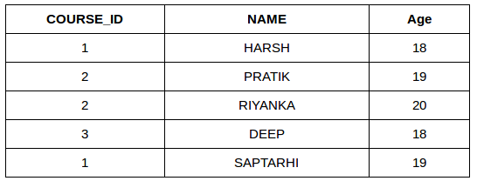
JOIN STATEMENTS
OUTPUT

Slide 111
JOIN STATEMENTS
LEFT (LEFT OUTER JOIN) JOIN:
Returns all records from the left table, and the matched records from the right table
This join returns all the rows of the table on the left side of the join and matching rows for the table on the right side of join. The rows for which there is no matching row on right side, the result-set will contain null. LEFT JOIN is also known as LEFT OUTER JOIN.

Slide 112
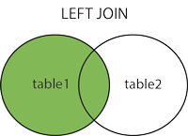
JOIN STATEMENTS

Slide 113
JOIN STATEMENTS
Syntax:
SELECTtable1.column1,table1.column2,table2.column1,.... FROM table1 LEFT JOIN table2 ON table1.matching_column = table2.matching_column;
table1: First table.
table2: Second table matching_column: Column common to both the tables.

Slide 114
JOIN STATEMENTS
EXAMPLE: (CONSIDER STUDENT , STUDENTCOURSE TABLE)
SELECTStudent.NAME,StudentCourse.COURSE_ID FROM Student LEFT JOIN StudentCourse ON StudentCourse.ROLL_NO = Student.ROLL_NO;

Slide 115
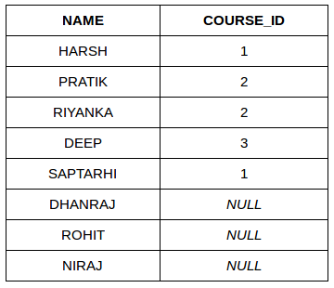
JOIN STATEMENTS
OUTPUT:

Slide 116
JOIN STATEMENTS
RIGHT ( RIGHT OUTER JOIN) JOIN:
Returns all records from the right table, and the matched records from the left table.
RIGHT JOIN is similar to LEFT JOIN. This join returns all the rows of the table on the right side of the join and matching rows for the table on the left side of join. The rows for which there is no matching row on left side, the result-set will contain null. RIGHT JOIN is also known as RIGHT OUTER JOIN.

Slide 117
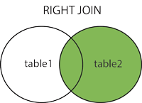
JOIN STATEMENTS

Slide 118
JOIN STATEMENTS
Syntax:
SELECTtable1.column1,table1.column2,table2.column1,.... FROM table1 RIGHT JOIN table2 ON table1.matching_column = table2.matching_column;
table1: First table. table2: Second table matching_column: Column common to both the tables.

Slide 119
JOIN STATEMENTS
EXAMPLE: (CONSIDER STUDENT , STUDENTCOURSE TABLE)
SELECT Student.NAME,StudentCourse.COURSE_ID FROM Student RIGHT JOIN StudentCourse ON StudentCourse.ROLL_NO = Student.ROLL_NO;

Slide 120
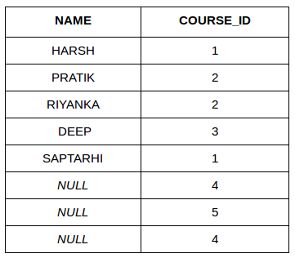
JOIN STATEMENTS
OUTPUT

Slide 121
JOIN STATEMENTS
FULL (OUTER JOIN OR FULL OUTER JOIN) JOIN:
Returns all records when there is a match in either left or right table.
FULL JOIN creates the result-set by combining result of both LEFT JOIN and RIGHT JOIN. The result-set will contain all the rows from both the tables. The rows for which there is no matching, the result-set will contain NULL values.

Slide 122
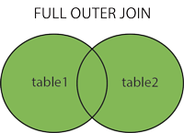
JOIN STATEMENTS

Slide 123
JOIN STATEMENTS
Syntax:
SELECTtable1.column1,table1.column2,table2.column1,.... FROM table1 FULL JOIN table2 ON table1.matching_column = table2.matching_column;
table1: First table. table2: Second table matching_column: Column common to both the tables.

Slide 124
JOIN STATEMENTS
EXAMPLE: (CONSIDER STUDENT , STUDENTCOURSE TABLE)
SELECTStudent.NAME,StudentCourse.COURSE_ID FROM Student FULL JOIN StudentCourse ON StudentCourse.ROLL_NO = Student.ROLL_NO;

Slide 125
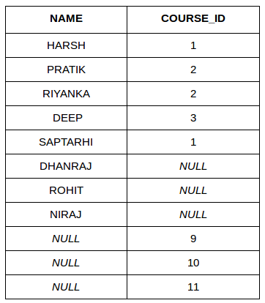
JOIN STATEMENTS
OUTPUT:

Slide 126
Set Operations
The set operations union, intersect, and except operate on relations and correspond to the relational algebra operations ∪, ∩, −.
Each of the above operations automatically eliminates duplicates; to retain all duplicates use the corresponding multiset versions union all, intersect all and except all.

Slide 127
Union:
Union
The SQL Union operation is used to combine the result of two or more SQL SELECT queries.
In the union operation, all the number of datatype and columns must be same in both the tables on which UNION operation is being applied.
The union operation eliminates the duplicate rows from its resultset.
Syntax:
SELECT column_name FROM table1
UNION
SELECT column_name FROM table2;

Slide 128
Union All
Union All operation is equal to the Union operation. It returns the set without removing duplication and sorting the data.
Syntax:
SELECT column_name FROM table1
UNION ALL
SELECT column_name FROM table2;

Slide 129
Intersect
It is used to combine two SELECT statements. The Intersect operation returns the common rows from both the SELECT statements.
In the Intersect operation, the number of datatype and columns must be the same.
It has no duplicates and it arranges the data in ascending order by default.
Syntax
SELECT column_name FROM table1
INTERSECT
SELECT column_name FROM table2;

Slide 130
Except:
This set operator is availed to retrieve the information of one table which is not available in another table.
Syntax:
SELECT column_name FROM table1
EXCEPT
SELECT column_name FROM table2;

Slide 131
Depositor table
Customer id | Customer name | amount
101 | aakash | 100000
102 | balaji | 200000
103 | sundar | 300000

Slide 132
Borrower table
Customer id | Customer name | amount
104 | jaishri | 500000
102 | balaji | 200000
106 | rengaraj | 700000

Slide 133
Union:
Find all customers who have a loan, an account, or both:
(select customer-name from depositor) union (select customer-name from borrower)
Output:
Aakash
Balaji
Sundar
Jaishri
rengaraj

Slide 134
Intersect
Find all customers who have both a loan and an account
(select customer-name from depositor) intersect (select customer-name from borrower)
Output:
balaji

Slide 135
Except:
Find all customers who have an account but no loan.
(select customer-name from depositor) except (select customer-name from borrower)
Output:
Aakash
sundar

Slide 136
Views
It is not necessary for all users to see the entire logical model (that is, all the actual relations stored in the database.)
Consider a person who needs to know an instructors name and department, but not the salary. This person should see a relation described, in SQL, by select ID, name, dept_name from instructor
A view provides a mechanism to hide certain data from the view of certain users.
Any relation that is not of the conceptual model but is made visible to a user as a “virtual relation” is called a view.

Slide 137
View Creation
A view is defined using the create view statement which has the form
create view v as < query expression >
where <query expression> is any legal SQL expression. The view name is represented by v.
SYNTAX:
CREATE VIEW view_name AS SELECT column1, column2..... FROM table_name WHERE condition;
Once a view is defined, the view name can be used to refer to the virtual relation that the view generates.
View definition is not the same as creating a new relation by evaluating the query expression
Rather, a view definition causes the saving of an expression; the expression is substituted into queries using the view.

Slide 138
Display view details
A view of instructors without their salary
create view faculty as select ID, name, dept_name from instructor
Find all instructors in the Biology department
select name from faculty where dept_name = 'Biology'
Create a view of department salary totals
create view departments_total_salary(dept_name, total_salary) as select dept_name, sum (salary) from instructor group by dept_name;

Slide 139
One view may be used in the expression defining another view
A view relation v₁ is said to depend directly on a view relation v₂ if v₂ is used in the expression defining v₁
A view relation v₁ is said to depend on view relation v₂ if either v₁ depends directly to v₂ or there is a path of dependencies from v₁ to v₂
A view relation v is said to be recursive if it depends on itself.

Slide 140
Materialized Views
Certain database systems allow view relations to be physically stored.
Physical copy created when the view is defined.
Such views are called Materialized view:
If relations used in the query are updated, the materialized view result becomes out of date
Need to maintain the view, by updating the view whenever the underlying relations are updated.

Slide 141
View Update
Add a new tuple to faculty view which we defined earlier
insert into faculty
values ('30765', 'Green', 'Music');
This insertion must be represented by the insertion into the instructor relation
Must have a value for salary.
Two approaches
Reject the insert
Inset the tuple
('30765', 'Green', 'Music', null)
into the instructor relation

Slide 142
Update Views Rules
Most SQL implementations allow updates only on simple views
The from clause has only one database relation.
The select clause contains only attribute names of the relation, and does not have any expressions, aggregates, or distinct specification.
Any attribute not listed in the select clause can be set to null
The query does not have a group by or having clause.

Slide 143
OPERATIONS IN A VIEW:
Inserting a row in a view: We can insert a row in a View in a same way as we do in a table. We can use the INSERT INTO statement of SQL to insert a row in a View.Syntax:INSERT INTO view_name(column1, column2 , column3,..) VALUES(value1, value2, value3..);

Slide 144
Deleting a row from a View: Deleting rows from a view is also as simple as deleting rows from a table. We can use the DELETE statement of SQL to delete rows from a view. Also deleting a row from a view first delete the row from the actual table and the change is then reflected in the view.Syntax:DELETE FROM view_name WHERE condition;

Slide 145
EXAMPLE: STUDENTDETAILS
SID | NAME | ADDRESS
1 | JAI | LONDON
2 | BALAJI | CANADA
3 | RENGARAJ | NETHERLAND
4 | VENKAT | SINGAPORE
5 | SUNDAR | MALAYSIA

Slide 146
EXAMPLE: STUDENTMARKS
ID | NAME | MARKS | AGE
1 | JOSHUA | 90 | 19
2 | BALAJI | 100 | 20
3 | RENGARAJ | 95 | 18
4 | VENKAT | 80 | 19
5 | SUNDAR | 90 | 20

Slide 147
VIEW CREATION:
CREATE VIEW DetailsView AS SELECT NAME, ADDRESS FROM StudentDetails WHERE S_ID <= 5;
SELECT * FROM DetailsView;

Slide 148
OUTPUT:DETAILSVIEW
NAME | ADDRESS
JAI | LONDON
BALAJI | CANADA
RENGARAJ | NETHERLAND
VENKAT | SINGAPORE
SUNDAR | MALAYSIA

Slide 149
CREATE VIEW MarksView AS SELECT StudentDetails.NAME, StudentDetails.ADDRESS, StudentMarks.MARKS FROM StudentDetails, StudentMarks WHERE StudentDetails.NAME = StudentMarks.NAME;
SELECT * FROM MarksView;

Slide 150
OUTPUT: MARKSVIEW
NAME | ADDRESS | MARKS
BALAJI | CANADA | 100
RENGARAJ | NETHERLAND | 95
VENKAT | SINGAPORE | 80
SUNDAR | MALAYSIA | 90

Slide 151
Transaction
A transaction consists of a sequence of query and/or update statements and is a “unit” of work
The SQL standard specifies that a transaction begins implicitly when an SQL statement is executed.
The transaction must end with one of the following statements:
Commit work. The updates performed by the transaction become permanent in the database.
Rollback work. All the updates performed by the SQL statements in the transaction are undone.
Atomic transaction
either fully executed or rolled back as if it never occurred
Isolation from concurrent transactions

Slide 152
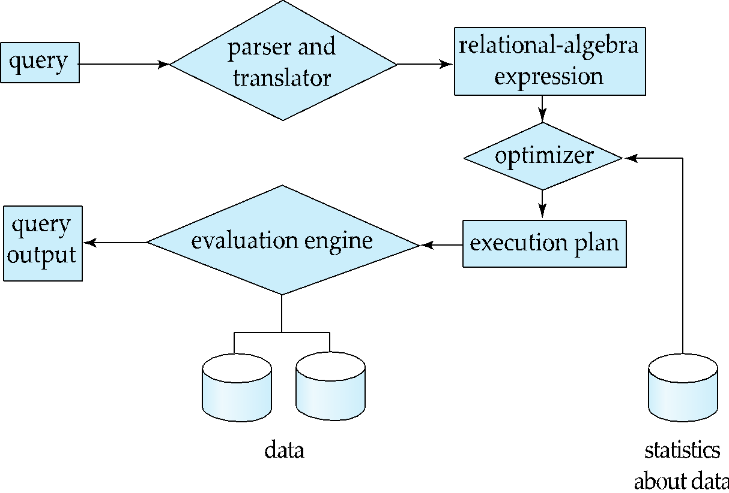
Basic Steps in Query Processing Query Processing is the activity performed in extracting data from the database. In query processing, it takes various steps for fetching the data from the database.
1. Parsing and translation
2. Optimization
3. Evaluation

Slide 153
A 3-step process that transforms a high-level query (of relational calculus/SQL) into an equivalent and more efficient lower-level query (of relational algebra).

Slide 154
Basic Steps in Query Processing (Cont.)
Parsing and translation
This is the first step of any query processing.
The user typically writes his requests in SQL language.
In order to process and execute this request, DBMS has to convert it into low level – machine understandable language.
Any query issued to the database is first picked by query processor.
It scans and parses the query into individual tokens and examines for the correctness of query.

Slide 155
Basic Steps in Query Processing (Cont.)
Check syntax and verify relations.
Translate the query into an equivalent relational algebra expression.
Once it is passed, then it converts each tokens into relational expressions, trees and graphs.
This phase of query processing is known as parsing and translation phase.
Example
SELECT *FROM STUDENT s, CLASS c WHERE s.CLASS_ID = c.CLASS_ID AND c.CLASS_NAME = ‘DESIGN_01’;

Slide 156
Basic Steps in Query Processing (Cont.)
The query processor scans the SQL query submitted and divides into individual meaningful tokens.
In our example, ’SELECT * FROM’, ‘STUDENT s’, ‘CLASS c’, ‘WHERE’, ‘s.CLASS_ID = c.CLASS_ID’, ‘AND’ and ‘c.CLASS_NAME = ‘DESIGN_01’’ are the different tokens.
It files query on the data dictionary tables(read-only set of tables) to verify if the tables and columns in these tokens exists or not.

Slide 157
Basic Steps in Query Processing (Cont.)
Relational Algebra
The below query can be translated into either of the following relational-algebra expressions:
select salary from instructor where salary < 75000;
., σ_{salary<75000}(∏_{salary}(instructor)) is equivalent to ∏_{salary}(σ_{salary<75000}(instructor))

Slide 158
Relational Algebra
Relational algebra is a procedural query language, which takes instances of relations as input and yields instances of relations as output.
It uses operators to perform queries.
An operator can be either unary or binary.

Slide 159
The fundamental operations of relational algebra are as follows −
Select Operation
Project Operation
Composition of Relational Operations
Union Operation
Set intersection operation
Set-Difference Operation
Cartesian-Product Operation
Rename Operation

Slide 160
Select Operation (σ)
It selects tuples that satisfy the given predicate from a relation.
Where σ stands for selection predicate and r stands for relation. p is prepositional logic formula which may use connectors like and, or, and not.
Example
σ_{subject = "database"}(Books)
Output − Selects tuples from books where subject is 'database'.
σsubject = "database" and price = "450"(Books)
Output − Selects tuples from books where subject is 'database' and 'price' is 450.

Slide 161
Project Operation (∏)
It projects column(s) that satisfy a given predicate.
Notation − ∏_{A1, A2, An} (r)
Where A₁, A₂ , A_{n} are attribute names of relation r.
Duplicate rows are automatically eliminated, as relation is a set.
Example
∏_{subject, author} (Books) Selects and projects columns named as subject and author from the relation Books

Slide 162
Union Operation (∪)
It performs binary union between two given relations and is defined as −
r ∪ s = { t | t ∈ r or t ∈ s} Notation − r U s
Where r and s are either database relations or relation result set (temporary relation).
Example
∏ _{author} (Books) ∪ ∏ _{author} (Articles)
Output − Projects the names of the authors who have either written a book or an article or both.

Slide 163
Set Intersection Operation (∩ )
It performs binary union between two given relations and is defined as −
r ∩ s = { t | t ∈ r and t ∈ s} Notation − r ∩ s
Where r and s are either database relations or relation result set (temporary relation).
Example
∏ _{author} (Books) ∩ ∏ _{author} (Articles)
Output − Projects the names of the authors who have written a book and an article .

Slide 164
Set Difference (−)
The result of set difference operation is tuples, which are present in one relation but are not in the second relation.
Notation − r − s
Finds all the tuples that are present in r but not in s.
∏ _{author} (Books) − ∏ _{author} (Articles)
Output − Provides the name of authors who have written books but not articles.

Slide 165
Cartesian Product (Χ)
Combines information of two different relations into one.
Notation − r Χ s
Where r and s are relations and their output will be defined as −
r Χ s = { q t | q ∈ r and t ∈ s}
σ_{author = 'tutorialspoint'}(Books Χ Articles)
Output − Yields a relation, which shows all the books and articles written by tutorialspoint.

Slide 166
Rename Operation (ρ)
The results of relational algebra are also relations but without any name.
The rename operation allows us to rename the output relation.
'rename' operation is denoted with small Greek letter rho ρ.
Notation − ρ _{x} (E)
Where the result of expression E is saved with name of x.

Slide 167
Assignment Operation (←)
It is similar to assignment operator in programming languages.
Denoted by ←
It is useful in the situation where it is required to write relational algebra expressions by using temporary relation variables.
The database might be modified if assignment to a permanent relation is made.

Slide 168
Natural join Operation (|Χ| )
It is a binary operation, combination of some selections and forms cartesian product of its two arguments.
Forms cartesian product, then performs selection forcing equality on the attributes appearing in both relations and ultimately removes duplicate attributes.
Represented by r |Χ| s, where r and s are relations.

Slide 169
Composition of Operations
It is possible to build relational algebra expressions using multiple operators similar to the use of arithmetic operators (nesting of operators)

Slide 170
Introduction to PL/SQL
Procedural Language extension for SQL
Oracle Proprietary
3GL Capabilities
Integration of SQL
Portable within Oracle data bases
Callable from any client

Slide 171
Structure of PL/SQL
PL/SQL is Block Structured
A block is the basic unit from which all PL/SQL programs are built. A block can be named (functions and procedures) or anonymous
Sections of block
1- Header Section
2- Declaration Section
3- Executable Section
4- Exception Section

Slide 172
Structure of PL/SQL
HEADER
Type and Name of block
DECLARE
Variables; Constants; Cursors;
BEGIN
PL/SQL and SQL Statements
EXCEPTION
Exception handlers
END;

Slide 173
Structure of PL/SQL
DECLARE
a number;
text1 varchar2(20);
text2 varchar2(20) := “HI”;
BEGIN
---------- ---------- ----------
END;
Important Data Types in PL/SQL include NUMBER, INTEGER, CHAR, VARCHAR2, DATE etc
to_date(‘02-05-2007','dd-mm-yyyy') { Converts String to Date}

Slide 174
Structure of PL/SQL
Data Types for specific columns
Variable_name Table_name.Column_name%type;
This syntax defines a variable of the type of the referenced column on the referenced table

Slide 175
PL/SQL Control Structure
PL/SQL has a number of control structures which includes:
Conditional controls
Iterative or loop controls.
Exception or error controls
It is these controls, used singly or together, that allow the PL/SQL developer to direct the flow of execution through the program.

Slide 176
PL/SQL Control Structure
Conditional Controls
IF....THEN....END IF;
IF....THEN...ELSE....END IF;
IF....THEN...ELSIF....THEN....ELSE....END IF;

Slide 177
PL/SQL Control Structure
LOOP
...SQL Statements...
EXIT;
END LOOP;
WHILE loops
WHILE condition LOOP
...SQL Statements...
END LOOP;
FOR loops
FOR <variable(numeric)> IN [REVERSE] <lowerbound>..<upperbound> LOOP .... ..... END LOOP;

Slide 178
PL/SQL Control Structure
Cursor
DECLARE name varchar2(20);
Cursor c1 is
select t.name
from table t
where date is not null;
BEGIN
OPEN c1;
LOOP
FETCH c1 into name;
exit when c1%NOTFOUND;
END LOOP;
CLOSE c1;
END;

Slide 179
Debuging
show error
DBMS_OUTPUT.PUT_LINE(‘ .. ‘);

Slide 180
Execution
How to execute a function in PL/SQL?
Var issue_flag number;
exec :issue_flag:=fun_name(arg1,arg2,. . . .);
PRINT :issue_flag;
How to execute a procedure in PL/SQL?
Exec procedure_name(arg1,arg2,. . . .);

Slide 181
TRIGGERS
A trigger is a stored procedure in database which automatically invokes whenever a special event in the database occurs. For example, a trigger can be invoked when a row is inserted into a specified table or when certain table columns are being updated.
Triggers are composed to be executed in light of any of the accompanying occasions.
A database control (DML) statement (DELETE, INSERT, or UPDATE).
A database definition (DDL) statement (CREATE, ALTER, or DROP).
A database operation (SERVERERROR, LOGON, LOGOFF, STARTUP, or SHUTDOWN).

Slide 182
TRIGGERS
The syntax of Triggers in SQL–
CREATE [OR REPLACE ] TRIGGER trigger_name
{BEFORE | AFTER | INSTEAD OF }
{INSERT [OR] | UPDATE [OR] | DELETE}
[OF col_name]
ON table_name
[REFERENCING OLD AS o NEW AS n]
[FOR EACH ROW]
WHEN (condition)
DECLARE
Declaration-statements
BEGIN
Executable-statements
EXCEPTION
Exception-handling-statements
END;
Create [OR REPLACE] TRIGGER trigger_name: It makes or replaces a current trigger with the trigger_name.

Slide 183
TRIGGERS
Where,
CREATE [OR REPLACE] TRIGGER trigger_name − Creates or replaces an existing trigger with the trigger_name.
{BEFORE | AFTER | INSTEAD OF} − This specifies when the trigger will be executed. The INSTEAD OF clause is used for creating trigger on a view.
{INSERT [OR] | UPDATE [OR] | DELETE} − This specifies the DML operation.
[OF col_name] − This specifies the column name that will be updated.
[ON table_name] − This specifies the name of the table associated with the trigger.

Slide 184
TRIGGERS
[REFERENCING OLD AS o NEW AS n] − This allows you to refer new and old values for various DML statements, such as INSERT, UPDATE, and DELETE.
[FOR EACH ROW] − This specifies a row-level trigger, i.e., the trigger will be executed for each row being affected. Otherwise the trigger will execute just once when the SQL statement is executed, which is called a table level trigger.
WHEN (condition) − This provides a condition for rows for which the trigger would fire. This clause is valid only for row-level triggers.

Slide 185
TRIGGERS
Select * from customers;
Customer(table)
+----+----------+-----+-----------+----------+
| ID | NAME | AGE | ADDRESS | SALARY |
+----+----------+-----+-----------+----------+
| 1 | Ramesh | 32 | Ahmedabad | 2000.00 |
| 2 | Khilan | 25 | Delhi | 1500.00 |
| 3 | kaushik | 23 | Kota | 2000.00 |
| 4 | Chaitali | 25 | Mumbai | 6500.00 |
| 5 | Hardik | 27 | Bhopal | 8500.00 |
| 6 | Komal | 22 | MP | 4500.00 |
+----+----------+-----+-----------+----------+
EXAMPLE

Slide 186
TRIGGERS
The following program creates a row-level trigger for the customers table that would fire for INSERT or UPDATE or DELETE operations performed on the CUSTOMERS table. This trigger will display the salary difference between the old values and new values −

Slide 187
TRIGGERS
EXAMPLE
CREATE OR REPLACE TRIGGER display_salary_changes
BEFORE DELETE OR INSERT OR UPDATE ON customers
FOR EACH ROW
WHEN (NEW.ID > 0)
DECLARE
sal_diff number;
BEGIN
sal_diff := :NEW.salary - :OLD.salary;
dbms_output.put_line('Old salary: ' || :OLD.salary);
dbms_output.put_line('New salary: ' || :NEW.salary);
dbms_output.put_line('Salary difference: ' || sal_diff);
END;

Slide 188
TRIGGERS
After creating a Trigger, use it in the PL/SQL code for putting it in to action.
DECLARE
total_rows number(2);
BEGIN
UPDATE customers
SET salary = salary + 5000;
IF sql%notfound THEN
dbms_output.put_line('no customers updated');
ELSIF sql%found THEN
total_rows := sql%rowcount;
dbms_output.put_line( total_rows || ' customers updated ');
END IF;
END;
/

Slide 189
ADVANTAGES OF TRIGGERS
Triggers can be written for the following purposes −
Generating some derived column values automatically
Enforcing referential integrity
Event logging and storing information on table access
Auditing
Synchronous replication of tables
Imposing security authorizations
Preventing invalid transactions

